Slide 1
The role of NRENs in EOSC
Sarah Jones, GÉANT
sarah.jones@geant.org
Twitter: @sarahroams
SEE user forum, 3rd November 2021
#SEEUserForum
events.geant.org/event/904

Slide 2
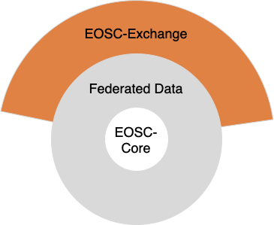
What is EOSC?
A web of FAIR data and services
Federation of eInfra and research infrastructures
Environment in which data can be brought together with services to perform analyses and address societal challenges

Slide 3


Aims to enable multidisciplinary discovery & use
Disconnected silos to a federated infrastructure providing added value to researchers

Slide 4






How is EOSC governed and implemented
Steering Board
(MS / EC / EOSC-A)
EOSC Association
coordinates and steers
Board
General Assembly of Members and Observers
Advisory Groups and Task Forces
https://eosc.eu
Implementation through many projects

Slide 5
NRENs are active in the EOSC Association
Members of the Association e.g. ULAKBIM, GRNET
Mandated representatives for their country e.g. ARNES, KIFU
Sit on the Board e.g. GÉANT & HEAnet
Chair of Task Forces etc e.g. Jisc & Uninett
Enables NRENs to influence strategic agenda and ensure needs of their country / researchers are reflected in EOSC
Notes:
Explain what an NREN is

Slide 6
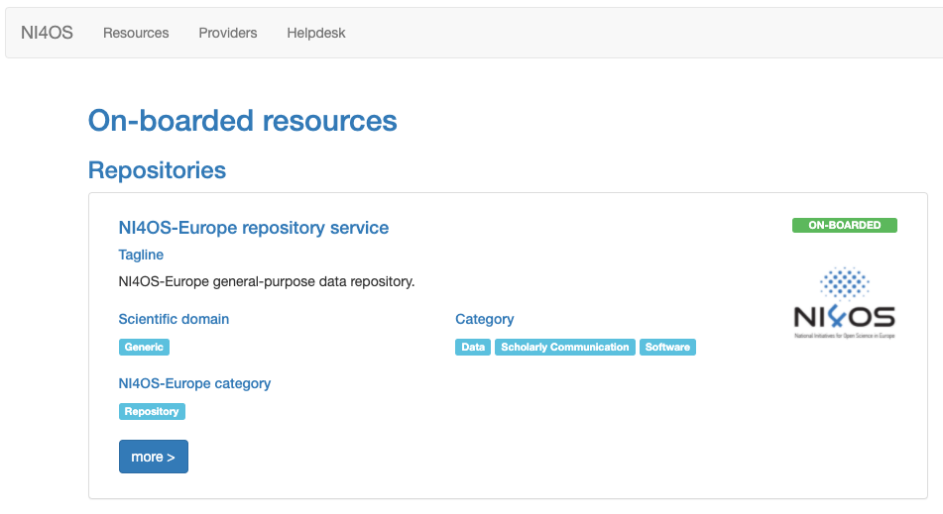



NRENs are also implementing EOSC via projects
Offering services in EOSC (e.g. AAI & cloud storage)
Developing new functionality (e.g. AI-based recommendations)
Developing national / regional catalogues to integrate in EOSC

Slide 7
Why engage in EOSC via your NREN?
Ensures they can represent your views in the governance and projects
Provides you with a local contact who speaks your language and understands the national research culture and services
The NREN can act as an intermediary, helping you to identify and use relevant datasets and services

Slide 8
What’s in EOSC for you as a researcher
Access to data from various repositories in Europe
Access to services to store, analyse, share data
Access to free compute resources e.g. via EGI-Ace, DICE and C-SCALE
Support for data management, Open Science and FAIR
A place to connect with other research communities

Slide 9

EOSC services can help to make data FAIR
Make data discoverable via catalogues
Assign Persistent Identifiers to help gain credit
Link data with papers and software
Improve your citation rates

Slide 10
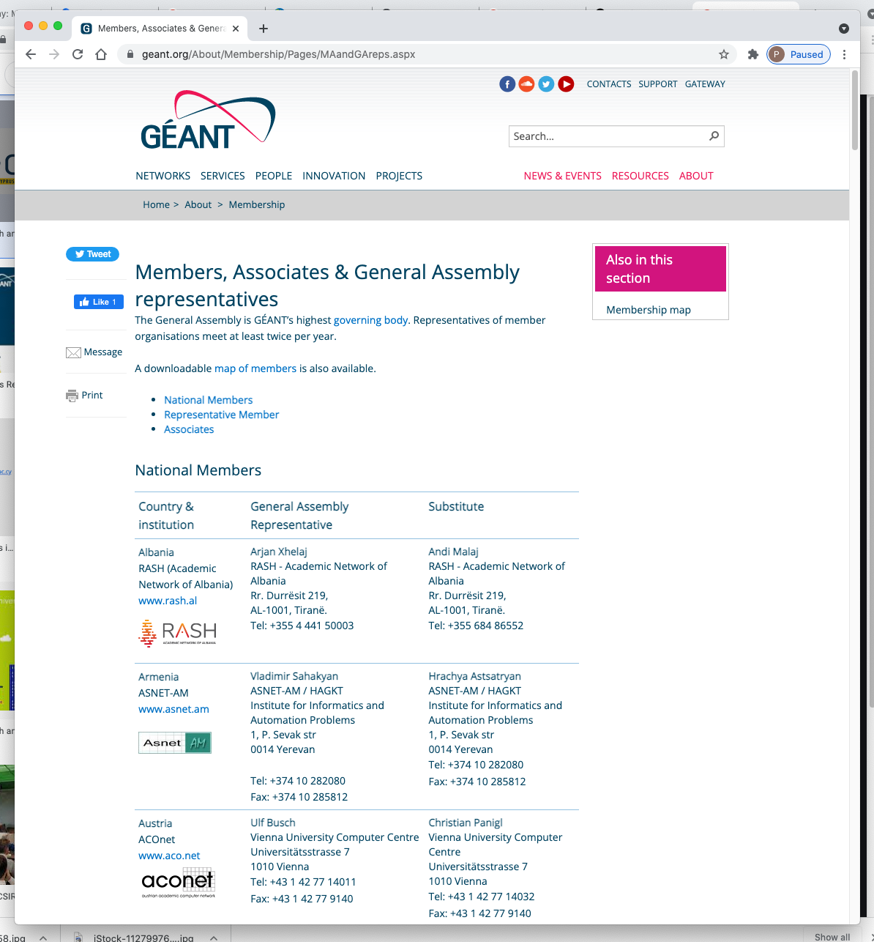










Contact details for SEE NRENs
www.geant.org/About/Membership/
Pages/MAandGAreps.aspx
Notes:
You can find out all contact details for each NREN on GÉANT website, link on the right side. Or just get in touch with us and we will be able to redirect you to the right address!

Slide 11

Questions?
Thanks!

