Slide 1
2021 SEE USER FORUM
3-4 November 2021
Leveraging Centralized AAI for Access to Research Resources
Vojdan Kjorveziroski
As part of the GÉANT 2020 Framework Partnership Agreement (FPA), the project receives funding from the European Union's Horizon 2020 research and innovation programme under Grant Agreement No. 856726 (GN4-3).​​​

Slide 2
Agenda
Introduction to FINKI Cloud
The need for a centralized compute infrastructure
Opening the service to external users
Integration with the NI4OS AAI
Added value and EOSC integration

Slide 3
The Case of FINKI Cloud
3

Slide 4
Introducing FINKI Cloud
FINKI Cloud (openstack.finki.ukim.mk) – infrastructure as a service (IaaS), hosted at the Faculty of Computer Science and Engineering (FCSE), UKIM
A production service since 2019
Based on the open-source OpenStack software
Targeted at the research and education community, allowing usage of virtual infrastructure
Virtual Machines
Disk space
Networking

Slide 5
FINKI Cloud – Showcase
Fast
Deployment of virtual resources in a matter of minutes
Secure
Strict isolation between users by default, with an option for shared spaces
Data Sovereignty
Deployed on-premise at FCSE
Familiar
Intuitive interface with a wide selection of popular VM base images
Easy-to-use
Wizard driven deployment processes without need for CLI interaction, by default

Slide 6
The Driving Ideas Behind FINKI Cloud
Extend the infrastructure to support outside users
Act as a computing hub for local and regional researchers, fostering collaboration
Boost research quality and quantity
Provide a cost-effective way for researchers to access the high-performance infrastructure, on demand

Slide 7
The User Access Conundrum
Problem: How to provide an integrated way of sharing resources with others?
Solution: Integrate using the University Identity Providers (IdP)
2nd problem: How to give access to outside researchers?
Not necessarily from our country
Independent researchers should be included as well
Infeasible to add support for all IdPs and social login options within the service
An abstraction layer is needed to fill the gap…

Slide 8
What is an AAI?
AAI – Authentication and Authorization Infrastructure
An abstraction layer between the service and the necessary user authentication and authorization flow
Allows users to access services using their own existing accounts:
Institutional login
Social login
A form of Bring Your Own Identity (BYOI)
A necessary building block of EOSC
8

Slide 9
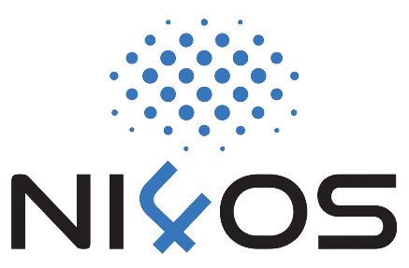
NI4OS AAI to the Rescue
Integration with NI4OS AAI, using SAML
Out-of-the-box support by OpenStack
Separate Virtual Organization (VO) within NI4OS AAI, limiting access to the service only to approved members
Users must reapply after 1 year
Greatly improved accessibility
Any local, regional, or international researcher can sign-up and use the service, after approval
Facilitating cooperation at the personal and institutional level
Onboarding into the NI4OS service catalog (catalogue.ni4os.eu)

Slide 10
General Benefits of an AAI Integration
User mobility and collaboration
Increased privacy and security
Improved user experience
Secure access based solely on users’ identity
Faster service development
Easier service promotion

Slide 11
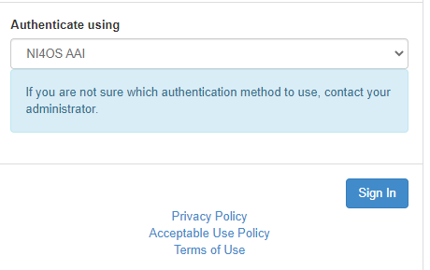
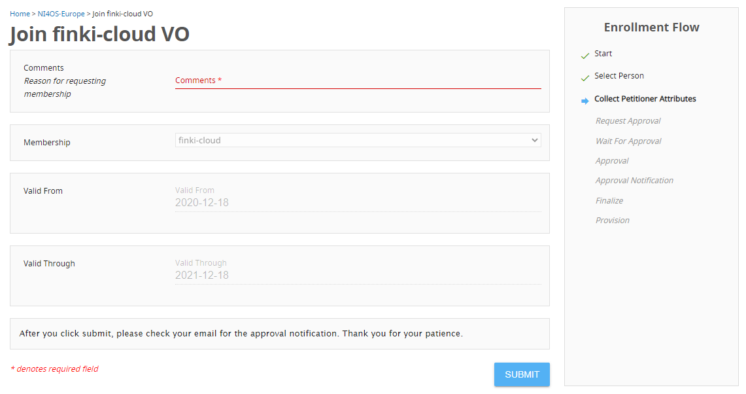
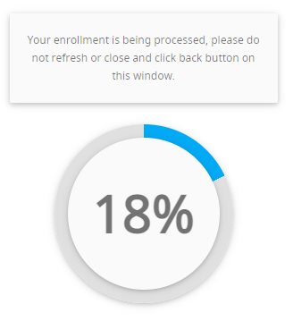
NI4OS AAI in Action

Slide 12
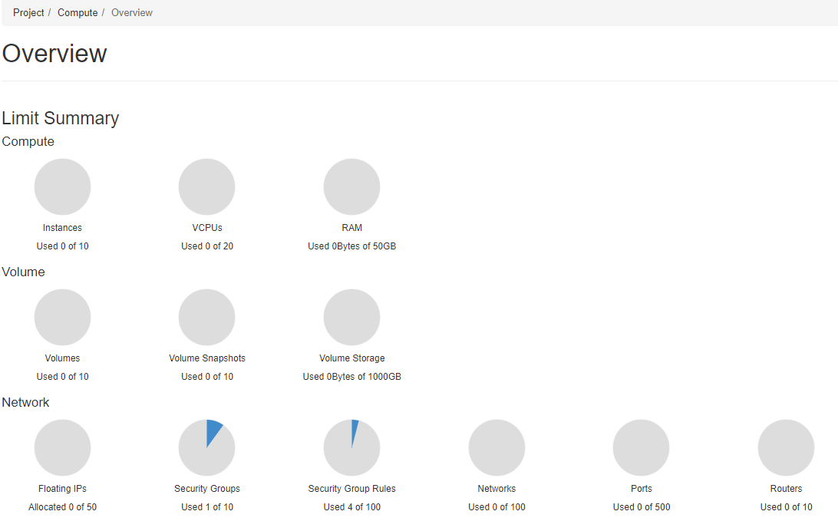
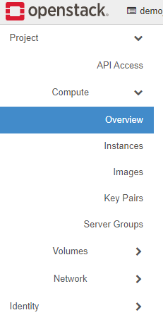
NI4OS AAI in Action: Showtime

Slide 13
Added Value
Automatic user provisioning within FINKI Cloud
Approval workflow external to the service
Limit access without explicitly disabling the user account
Support for social login, apart from institutions part of EduGAIN
Ability to publish and promote the service within the wider EOSC community
https://catalogue.ni4os.eu/?_=/resource/id/e9ba68b9-5f2d-4359-9372-b6fffd8ccb24
13

Slide 14
Thank you
Any questions?
As part of the GÉANT 2020 Framework Partnership Agreement (FPA), the project receives funding from the European Union's Horizon 2020 research and innovation programme under Grant Agreement No. 856726 (GN4-3).​​​

